Slide 1
Lab 7: APIs

Slide 2
By the end of this lab, you’ll be able to
Define APIs
Explain what a protocol is and understand HTTP
Make GET and POST requests
Learn how to process JSON responses

Slide 3
What is an API?
1

Slide 4
APIs
An Application Programming Interface is a software to software interface that allows programs to exchange data.
One prominent example is Google’s API. Every time you’re on an app that allows you to login via Google, you’re using Google’s Authentication API!

Slide 5
How does it work?
You can use an API by using functions from its Interface
An Interface is a set of functions that can be accessed by other parts of the program (or in this case, other programs entirely!).
For this lab we’ll be using the Alpha Vantage API.
Check their Documentation to see their many functions.
There are a lot but that just means it’s a super useful API!

Slide 6
API Components
On the National Weather Service API Documentation page you’ll notice
They look an awful lot like functions.
We call these endpoints
they work very similarly to functions!
Just like with functions, endpoints can take arguments.
In API land, we call these arguments parameters.
They can include things like numbers, strings, etc.

Slide 7
API Keys
The API Key is an important parameter in many APIs.
It is unique to each user
It is an identifier that ties the request to the user.
It’s used for things like rate limiting (limiting the amount of requests/calls that can be made) and detecting misbehavior.

Slide 8
API Requests
2
Let’s start with the first set of slides

Slide 9
“Calling” API Endpoints
We can call functions in python, but how do we call something through the internet?
Every time you navigate to a website you’re pretty much hitting an endpoint and sending an HTTP Request for the web page at that endpoint!
(Requests usually follow the RESTful framework. If you’re interested, read more about it here!).

Slide 10
HTTP
Just like the functions we’re used to by now, we need a language to express these calls/requests.
This language is HTTP, which stands for Hypertext Transfer Protocol.
You might’ve seen http:// or https:// in the beginning of URLs.
That just says which protocol you are using to make requests!

Slide 11
HTTP and URLs
There’s not much you need to know about HTTP at the moment,
but knowing how URLs are structure is useful
Let’s take a look at one of Cat Facts API endpoint:
https://catfact.ninja/breeds?limit=500&page=2
Host
Parameter(s)
Protocol
Endpoint

Slide 12
Types of Requests
GET gets a resource (like a website or data).
This is the most common type of web request and simply requests data without modifying anything on the server side.
POST: posts some data to a server.
Think: when you login or create an account you’re posting some information to a server somewhere.

Slide 13
Types of Requests
Other types of requests include:
PUT (which is usually used for updating elements in a remote database)
DELETE (which removes an element of data in a server).

Slide 14
GET Request Visualization
Client
Server
GET https://catfact.ninja/breeds
Goes and finds data to fulfill your request
{
“weird”:[“response format that looks”],
“like”: “this.”
}
Sends back JSON response

Slide 15
POST Request Visualization
Client
Server
POST
https://facebook.com/create_account
Adds your account to their database.
Gets back web page!
Finds greeting webpage and sends it back!

Slide 16
Making GET Requests in Python
import requests - Step 1: import requersts
url = "http://apimeme.com/meme" - Step 2: build your request
params = {"meme": "Arthur-Fist", "top": "CS112 is", "bottom" : "the best!"}
response = requests.get(url, params=params) - Step 3: GET
created_image = open("cs112_meme.png", "wb+")
created_image.write(response.content)
What does this code do? Open the image...

Slide 17
Making POST Requests in Python
You won't need to do this for this lab, but the process is similar to that of GET requests.
import requests
url = "http://random.api/that-does-not-exist"
data = {"your": "data", "would": "go here."}
response = requests.post(url, data=data)
# process response data
Unfortunately the code above won't work. Since POST requests actually modify data on the backend, they're harder to demo.

Slide 18
API Responses
3
JSONs!

Slide 19
JSON Introduction
JSON JavaScript Object Notation is syntax for exchanging information!
when making requests or receiving responses, all we can do is send/receive data (as a string!).
JSON syntax is very similar to Python dictionary syntax.
Information is stored as key, value pairs, but of various types.
You could have a string key whose value is a string, a list or a whole other dictionary!

Slide 20
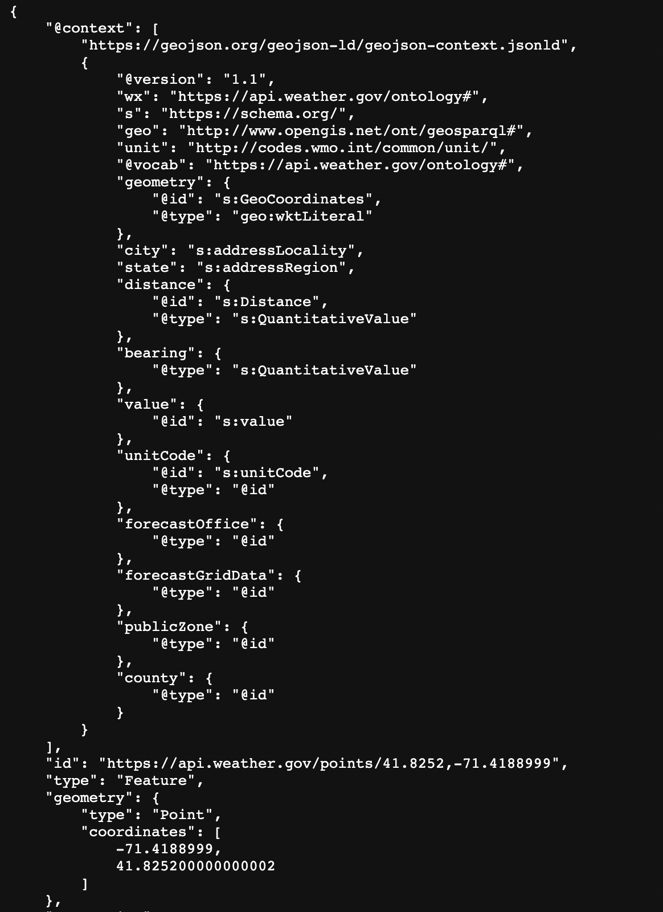
JSON Example

Slide 21
Accessing JSON in Python
After making a request, you can access the data from the response by calling the json().
import requests
url = "https://catfact.ninja/breeds"
params = {"limit": "20"}
response = requests.get(url, params=params)
json_response = response.json()

Slide 22
JSON Shortened Response from Cat Facts
{
"current_page": 1,
"data": [
{
"breed": "Abyssinian",
"country": "Ethiopia",
"origin": "Natural/Standard",
"coat": "Short",
"pattern": "Ticked"
},
{
"breed": "Aegean",
"country": "Greece",
"origin": "Natural/Standard",
"coat": "Semi-long",
"pattern": "Bi- or tri-colored"
},
...
],
"first_page_url": "https://catfact.ninja/breeds?page=1",
...
}

Slide 23
Accessing JSON in Python
So, from where we left off on slide 19, let's say we want to access the first 10 breeds and store them in our own dictionary that maps coat type to breed name :
json_response = response.json()["data"]
coats = {}
for i in range(min(len(json_response), 10)):
breed_info = json_response[i]
coat_type = breed_info["coat"]
if coat_type not in coats:
coats[coat_type] = []
coats[coat_type].append(breed_info["breed"])

Slide 24
Any Questions?

